Slide 1


SAP CLOUD APPLICATION PROGRAMMING AND XSA TRAINING IN BTP
Anubhav Oberoy
Day – 4

Slide 2

Agenda – Day 4
Concept of Localization
Localization of Dynamic Content
Localization of Static Content
Loading data in Database
Introduction to OData
Understanding the use of OData services
Operations related to the OData Service
OData query options
Exposing the OData in the CAPM
Implementing OData service
Introduction to OData V2 Proxy
Converting OData V4 to OData V2
Introduction to Postman Tool
Check the CURD operations using the Postman.
Introduction to Views in SAP CAP
Why we need Views.

Slide 3
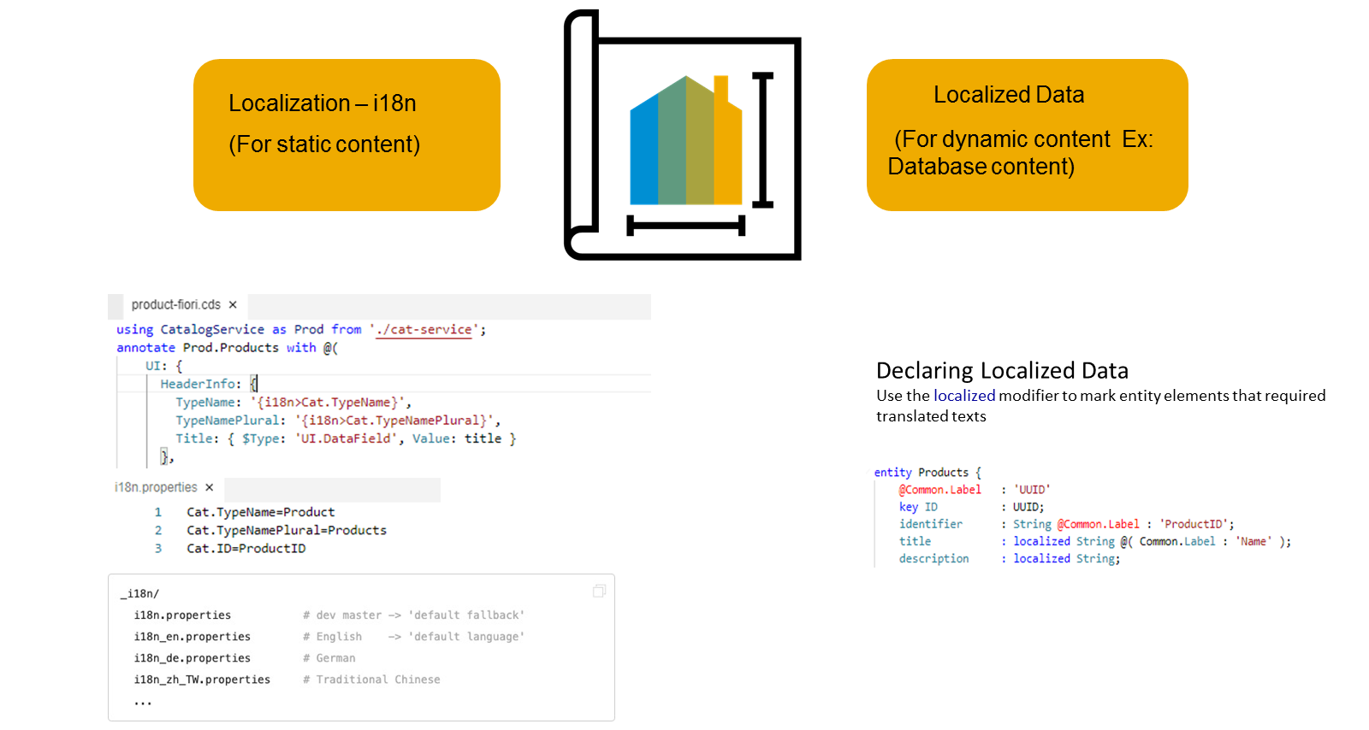
Concept of Localization
Localization refers to adapting your business application to different languages to cater to specific regional markets. This is important for anything that is visible in the UIs.
Localization is split into two categories, Localization for static content and Localization for dynamic content
Localization for dynamic content
This is achieved by marking the attributes that need to support multiple languages with a special keyword called "localized", this then creates a text table for each entity which has attributes defined as "localized"
Dynamic content that depends on the data that is stored in our persistence service.
The attributes that need to support multiple languages need to be marked with a special keyword called "localized", as we see here. In this case a text table is created for the entity.
DESCRIPTION: localized String(255);

Slide 4
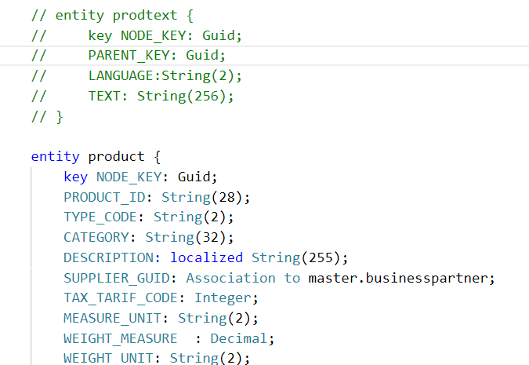
Hands-on: Dynamic Localization
In products entity remove the DESC_GUID field and add DESCRIPTION field aa localized String(255);
Exercise Code:
datamodel.cds

Slide 5

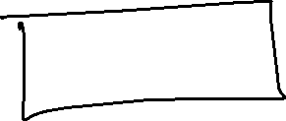


























Slide 6
Localization for Static Content
This is achieved by externalizing all your text literals into separate text bundle files that we call the internationalization files, or in short, i18n files.
You need to maintain a separate i18n file for each language that you'd like to support.
In these i18n files, we store the actual static text as key and value pairs. Your code can then refer to the respective keys as we see here in this picture.

Slide 7

Hands-on: Localization of Data
Now we will use the annotation to give labels to the entities in our datamodel. To check the labels in the metadata we have implement a service and expose the business partner entity in the service.
Part 1: Annotating the entity in the same file
Exercise code/resource:
datamodel.cds
i18n.properties
Part 2: Annotating the properties from another file.
Exercise code/resources:
index.cds
datamodel.cds
i18n.properties
i18n_de.properties

Slide 8
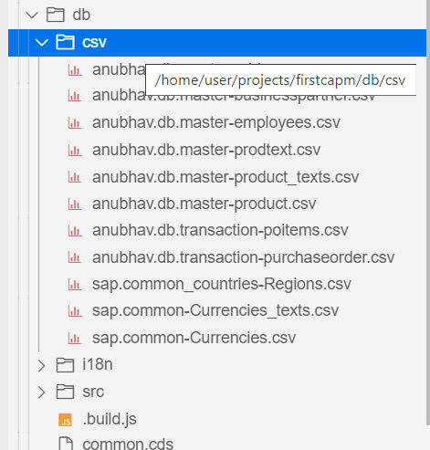
Loading initial Data in HANA Database
CSV files in your project are picked up by deployments for both SQLite and SAP HANA.
Steps to add data
The files must be located in the db/csv, db/data, or db/src/csv folders.
Each file contains data for one entity.
Filenames must follow the pattern namespace-entity.csv.
Pattern for nested entities: namespace-entity.nestedEntity.csv.
Examples: anubhav.db.master-address.csv
They must start with a header line that lists the needed element names.
When we do cds deploy --to hana
Behind the scenes it generates hdbtabledata files for the CSV files in the project. If an hdbtabledata file is already present next to the CSV files, no new file is generated.

Slide 9
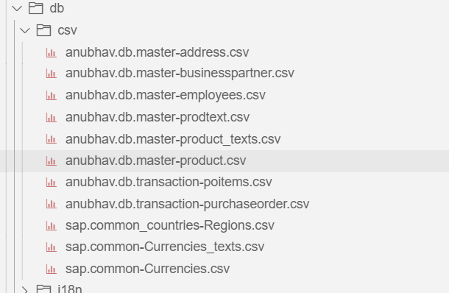
Hands-on: Loading Initial Data
In this exercise we will deploy the business partner table and address table to the HANA Cloud Database.
Exercise code/resource:
csv files

Slide 10
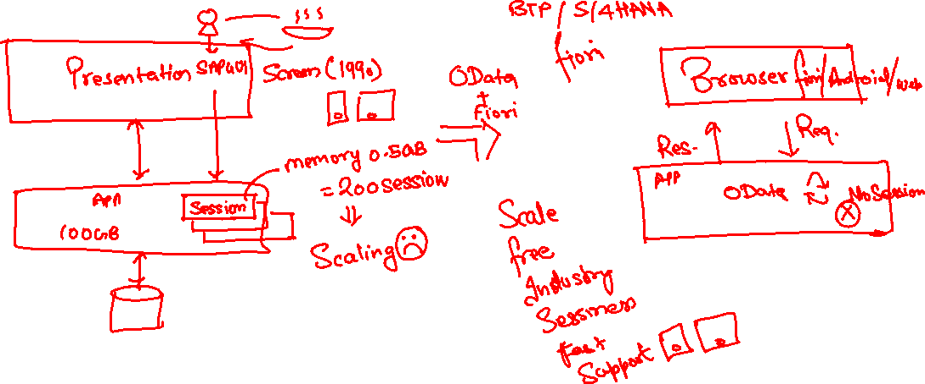
What is OData?
OData Stands for Open Data Protocol, it is an OASIS standard to communicate to server using REST based service. It was acquired by Microsoft in 2012 and adopted by many companies to build REST services to expose data over internet HTTP/HTTPs protocol.
Funda Fox
Fiori cannot talk to FM, program, CDS views, …. Fiori only and only talk to OData service which is built on top of FM, ABAP code, CDS view, etc.

Slide 11
OData Basics
This OData Protocol is mainly used to expose data over HTTP. It does not matter from consumer point, which technology the OData is built on. This way we are abstracted from the underlaying programming/database. Fiori only and only understand OData, it cannot talk to BAPI, BADI, FM, CDS View, Interface, Class.
Lets start understanding a sample OData given by Microsoft on odata.org
1. Service document – is a collection of entity sets to access the data.
An Entity set is built by an Entity Type. Entity Set is the right end point to perform CURDQ operations
Entity Type describes the structure of the data – metadata
https://services.odata.org/V3/Northwind/Northwind.svc/
2. Service metadata document – describes all the properties and entity types
Which includes key, properties, attributes (nullable, key, max length, create), NavigationProperty
Also includes the relations between entities called association (compare with Foreign key)
Usually one database table is considered as one entity.
https://services.odata.org/V3/Northwind/Northwind.svc/$metadata
https://chrome.google.com/webstore/detail/jsonview/chklaanhfefbnpoihckbnefhakgolnmc
https://chrome.google.com/webstore/detail/xml-tree/gbammbheopgpmaagmckhpjbfgdfkpadb

Slide 12
Structure of an OData URL
http(s)://hostname:port/sap/opu/odata/sap/SERVICENAME_SRV/ENTITYSET?p1=val&p2=val
Protocol
Address & Port
Service Name
End Point Access
Data
Path prefix
Query Options
Service root URL
Resource path
Service root URL: - The service root of a URL is the base URL of the service. When a GET request is made to this URL it will return a service document that defines all the resources available via that service.
Resource path: - A resource by REST definition is an object which is accessible over the HTTP by using the standard GET,POST,PUT,PATCH and DELETE methods.
Query options: - Query options are essentially standardized query string parameters that can be passed to an OData service to run queries on a requested resource. They can help perform certain operations like select, filter, count, skip, order, search and format on resources. All OData query options are prefixed by a $ sign and they are case-insensitive.

Slide 13


















Slide 14
Client Side Query with OData
Sets the page size of results.
02
$top
Indexes into a result set. Also used by some APIs to implement paging and can be used together with $top to manually page results.
Returns the results in the specified media format.
01
03
$format
$skip
ODATA Query
06
04
Retrieves related resources.
Filters properties (columns).
$expand
$select
05
$filter
Filters results (rows).

Slide 15
GET operations
Read All the data from Products (SELECT * FROM dbtab)
https://services.odata.org/V3/Northwind/Northwind.svc/Products?$format=json
Read few properties of entity (SELECT col1, col2 FROM dbtab)
https://services.odata.org/V3/Northwind/Northwind.svc/Products?$format=json&$select=ProductID,SupplierID
Read Top Records (Pagination SELECT * UP TO ROWS n ..)
https://services.odata.org/V3/Northwind/Northwind.svc/Products?$format=json&$top=3&$skip=10
Read data by filtering (SELECT * FROM dbtab WHERE condition)
https://services.odata.org/V3/Northwind/Northwind.svc/Products?$format=json&$filter=SupplierID%20eq%203
SELECT * FROM dbtab WHERE col LIKE ‘%pattern%’
https://services.odata.org/V3/Northwind/Northwind.svc/Products?$format=json&$filter=substringof(%27Cola%27,ProductName)%20eq%20true
Reading count of the records (SELECT COUNT(*) FROM dbtab)
https://services.odata.org/V3/Northwind/Northwind.svc/Products/$count
Reading Single record by its key (SELECT SINGLE * FROM edbtab WHERE pkey = ‘key’)
https://services.odata.org/V3/Northwind/Northwind.svc/Products(11)?$format=json
Join and read data together (SELECT * FROM tab1 INNER JOIN tab2 ON cond)
https://services.odata.org/V3/Northwind/Northwind.svc/Products(11)?$format=json&$expand=Supplier,Category

Slide 16
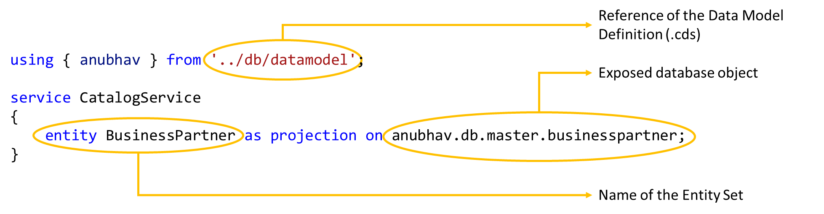
Exposing the OData Entity Set using CAPM
At design time, within the srv folder, you create an .cds file where you indicate the exposed database object, for example, table, view, calculation view, and so on, and the name of the Entity Set in the service.
On build, the application provides an OData service, exposing the object content under the given entity set name.
Syntax to Expose the OData Entity Set

Slide 17
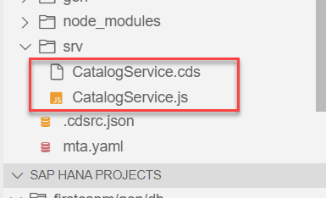
Hands-on: Exposing OData Entity
In this exercise we will expose the data form the database in the form of OData by creating a OData service.
Steps to do the exercise.
Initially we have created a CatalogService.cds and CatalogService.js file in the srv folder to check labels in the metadata.
The CatalogService.cds file is known as the service definition file.
Put the code in that file form the below link.
Run the Application using the command cds run or cds watch.
Exercise Code/Resource:
CatalogService.cds

Slide 18
OData V2 Service
SAP CAP framework by default provides the OData V4 in the OData service.
But in most of the application developed in the Industry is based on the V2 version of the OData service.
OData V4 is only supported by the Fiori - List Report Application (LRP).
So, to over come this issue sap provides a module which converts the OData V4 generated by the CAP framework to the OData V2.
Npm module provided by SAP: - @sap/cds-odata-v2-adapter-proxy
This module can be install by using the command
npm install @sap/cds-odata-v2-adapter-proxy
Now to use this module, we have to make a file named server.js in the /srv folder.
In this folder we have to write a bootstrap code to use the OData V2.
SAP CAP Framework
OData V2 Adapter proxy
OData V4
OData V2

Slide 19
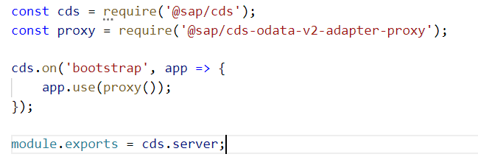
Hands-on: OData V2 Proxy
Create a new file server.js and write the bootstrapping code for the V2 adapter proxy.
Exercise Code/resource:
server.js

Slide 20

Introduction to POSTMAN Tool
Postman is an API platform for building and using APIs. Postman simplifies each step of the API lifecycle and streamlines collaboration so you can create better APIs—faster.
It is an interactive and automatic tool for verifying the APIs of your project.
It presents you with a friendly GUI for constructing requests and reading responses. ... Postman is the way to streamline the process of API testing.
Postman can run GET, POST, PUT, PATCH, MERGE, DELETE, and various other request methods as well, and has utilities to help with developing APIs. Free and paid versions are available for Mac, Windows, Linux, and as a Chrome app.
You can Download the postman tool from the link give below:
https://www.postman.com/downloads/

Slide 21
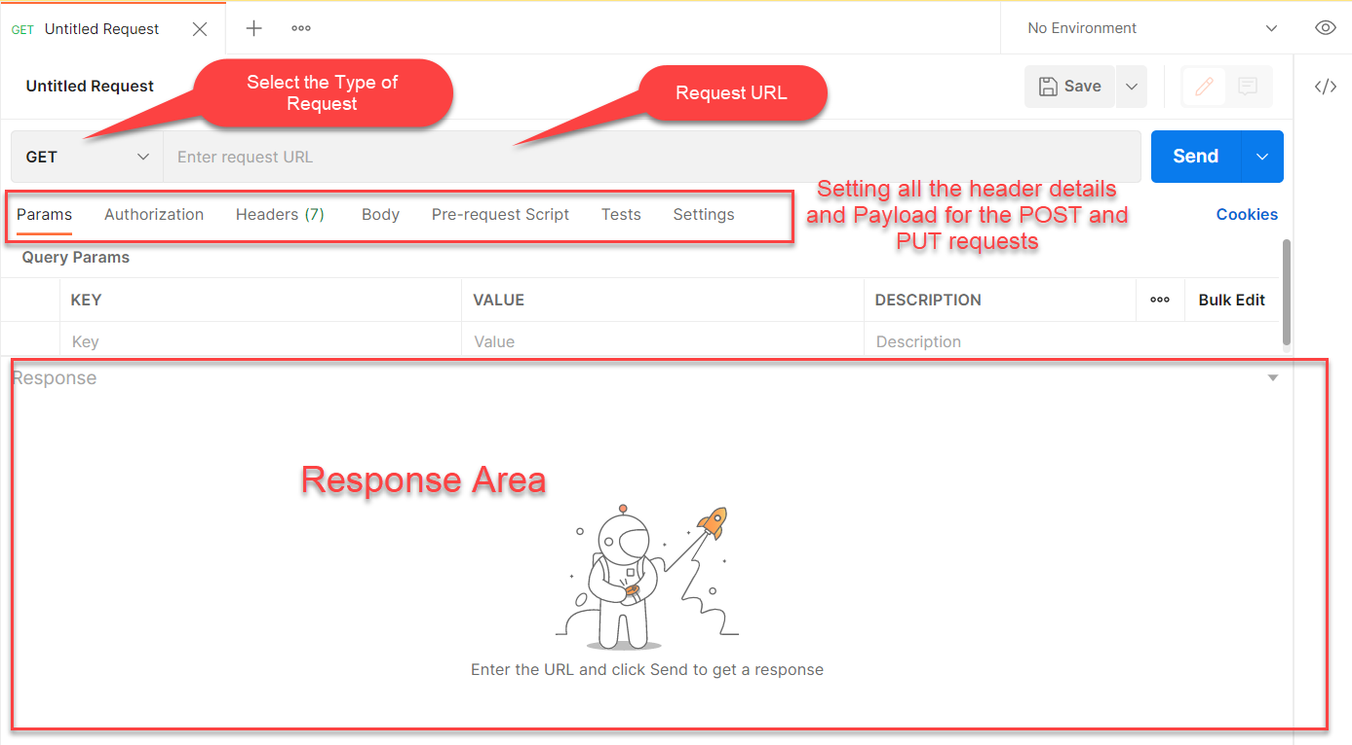
Postman App Layout
The below screen shot shows a basic layout of a request in Postman

Slide 22
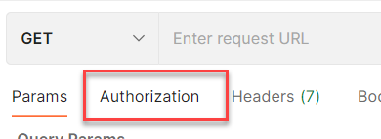
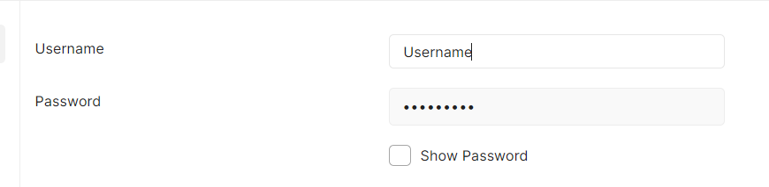
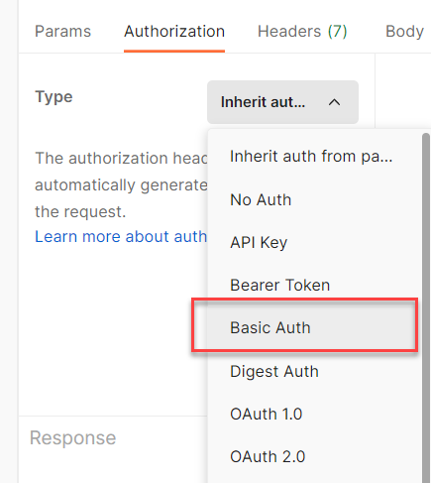
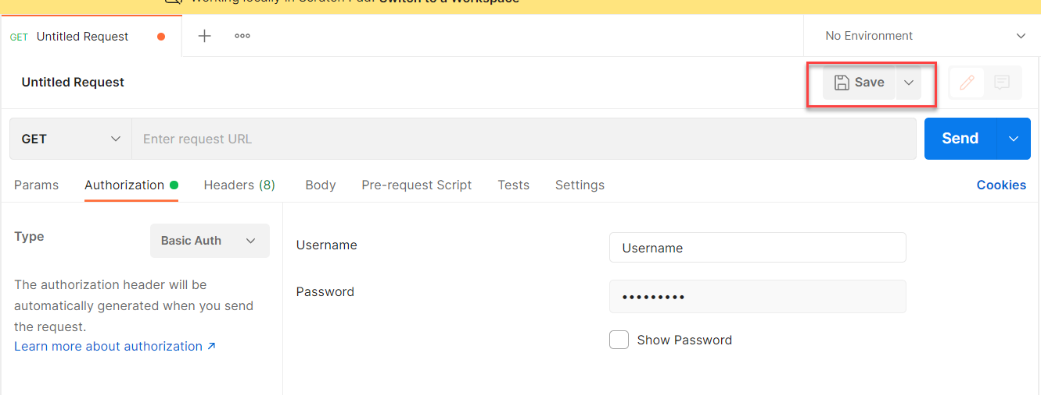
Setting Basic Auth in Postman
Step 1: Go to the Authorization section.
Step 3: Set the Username and Password.
Step 2: Select Basic Auth as Type
Step 4: Save.

Slide 23
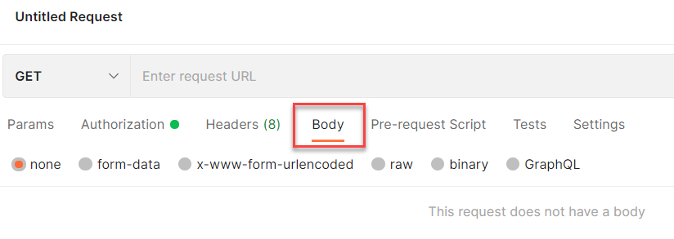
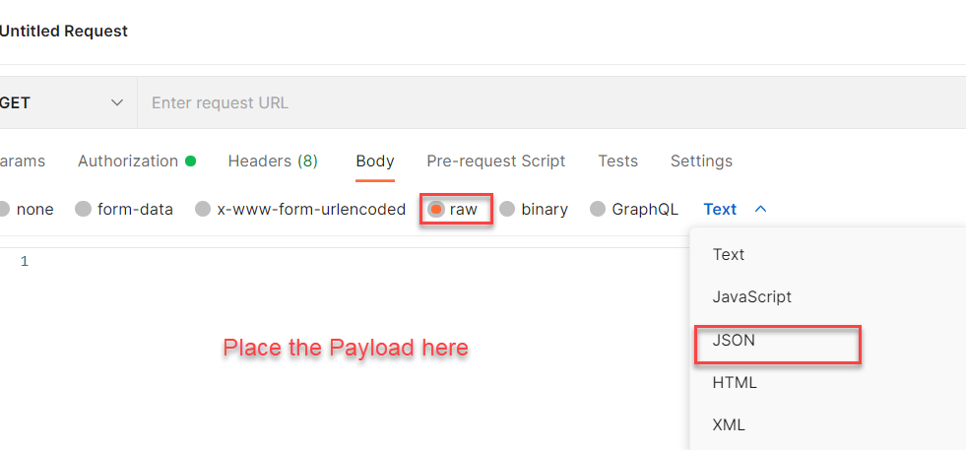
Setting the Payload for POST and PUT request
Step 1: Go to Body Section.
Step 2: Select the raw option form the radio button and then select the data type as JSON.

Slide 24
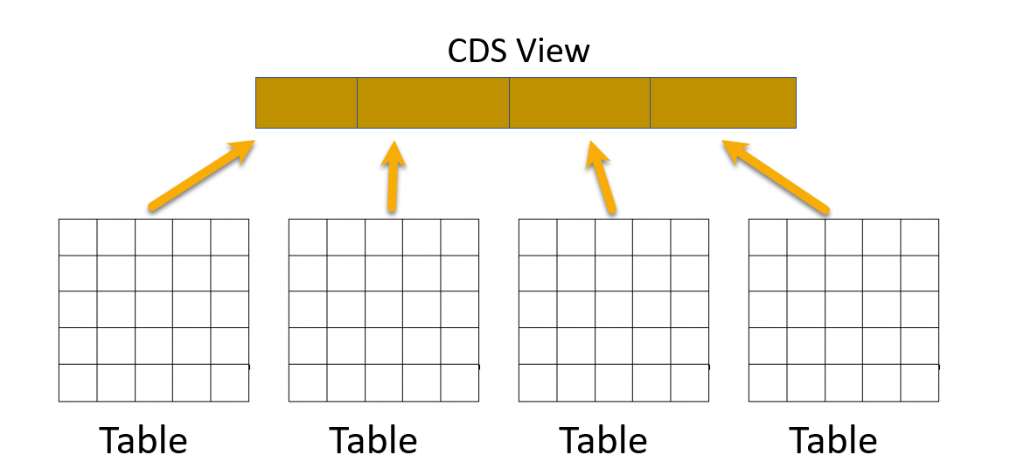
Introduction to Views in SAP CAP
Core Data Service (CDS) Views are virtual data models of SAP HANA which allows direct access to underlying tables of the HANA database.
SAP CDS Views aim to push logic from the application server to the client-side and database. This is defined by SAP as ‘Code -to-Data’ or ‘Code Pushdown’.
CDS Views is an important technology for modern application development on SAP systems and should not be overlooked. They provide enhancements in terms of data modelling and enable improved performance when combined with SAP HANA database.
CDS Views allow developers to create semantically rich data models which the application services expose to UI clients.
While the data in SAP is still physically stored in transparent tables, CDS Views are an abstraction layer on top of the tables for data modelling purposes. They understand the relationship between database tables and hide the complexity from the programmer.

Slide 25
Why we need views in a software
They display non-normalized data. The data is spread in multiple tables, and it is difficult for developers to every time write JOINs.
The application needs data which is presentable to user
View gives security because users cannot update data using view
They can aggregate data like find total sales per customer.
Expose columns of technical type to more semantic names
Syntax of defining Views
Use the as select from variant to use all possible features an underlying relational database would support using any valid CQL query including all query clauses.
Case Insensitive Naming of the View
Case Sensitive Naming of the View
define view ViewName as
select from table{
};
define view! [ViewName] as
select from table{
};

Slide 26
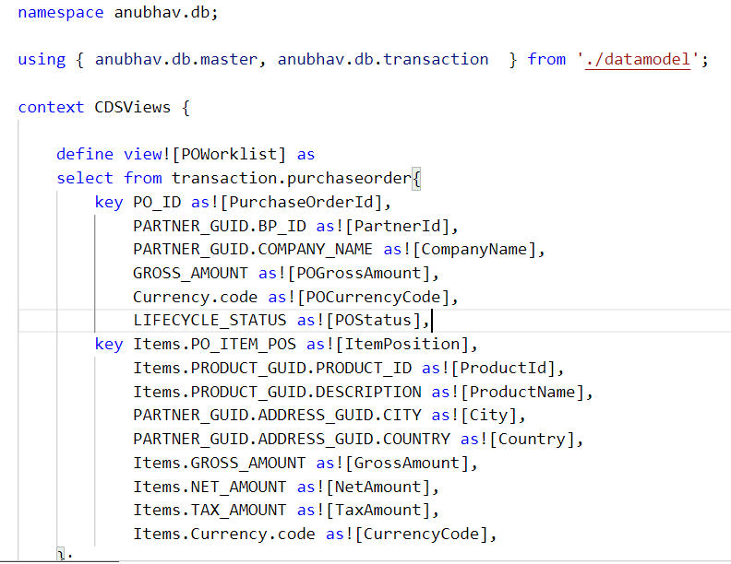
Hands-on: CDS Views
In this exercise we will create our first CDS View which will expose the non-normalized data for purchase order and purchase order items in combined form. We will expose this view using a new service named CDSService.
Exercise code/resource:
CDSViews.cds

Slide 27
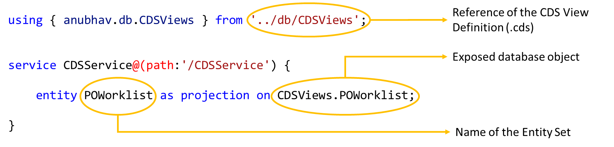
Exposing CDS Views in OData Entity Set
Syntax to Expose the CDS Views in OData Entity Set.
The syntax for exposing the CDS Views in the service is same as it is for the data model.
We just have to reference the CDS View Definition in place of the data model
And the CDS Views data object in place of the data models data object

Slide 28
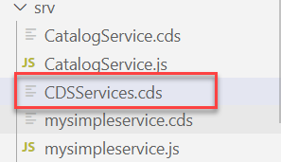
Exercise
In this exercise we will expose the data form the database in the form of OData by creating a OData service.
Steps to do the exercise.
Create a new file in /srv folder and name it as CDSServices.cds
Write the code to expose the cds view as service (past the code form below link)
Exercise Code/Resource:
CDSServices.cds

Slide 29

End of Day 4

Slide 30

Questions

Slide 31

Anubhav Oberoy

Slide 32


We’re committed to empower you to be
Most Desirable Resource
through powerful training solutions.
We build the workforce of the future.
250+
Corporate Clients
30,000+
Learners Trained
25000+
Learners Placed
FREE WEBINARS
Sign up for free webinars with industry experts every fortnight!
Enroll Now!
Contact us today!
https://anubhavtrainings.com/

Slide 33




More from AnubhavTrainings.com

Slide 34
Title
Content

